Slide 1
AI. Powered Flash Card Generator.
Cardify

Slide 2








TECH STACKS
Cardify
Powers the project
Meta Framework | NextJS TypeScript
Styling | TailwindCSS
Components | Mantine
AI Platform | OpenAI
Authentication | AuthJS Google
Icons | Phosphor

Slide 3

THE PURPOSE
Cardify
To simplify & help the learning experience, especially for students.

Slide 4



APP FLOW
Cardify
About Us
Services
Blog
Portfolio
Contact
Login
Create Project
Input Text
Generate
✨ Profit

Slide 5
APP
FEATURES
Cardify
OAuth2 Authentication
OpenAI Integration
PWA Support
Rich Text WYSIWYG Editor
Sharing Options

Slide 6
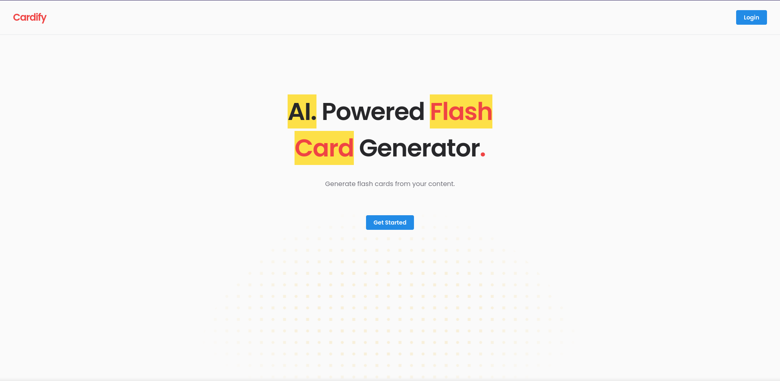
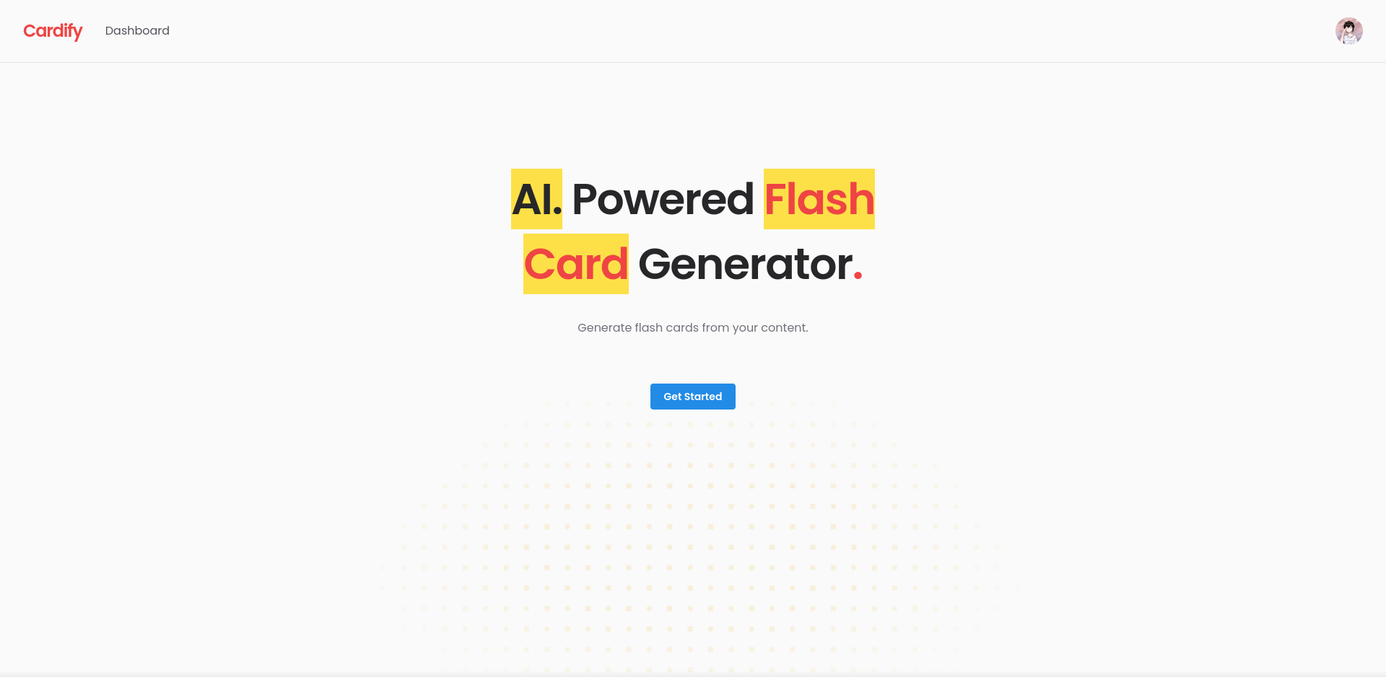
LANDING PAGE
Cardify
Logged Out
Logged In

Slide 7
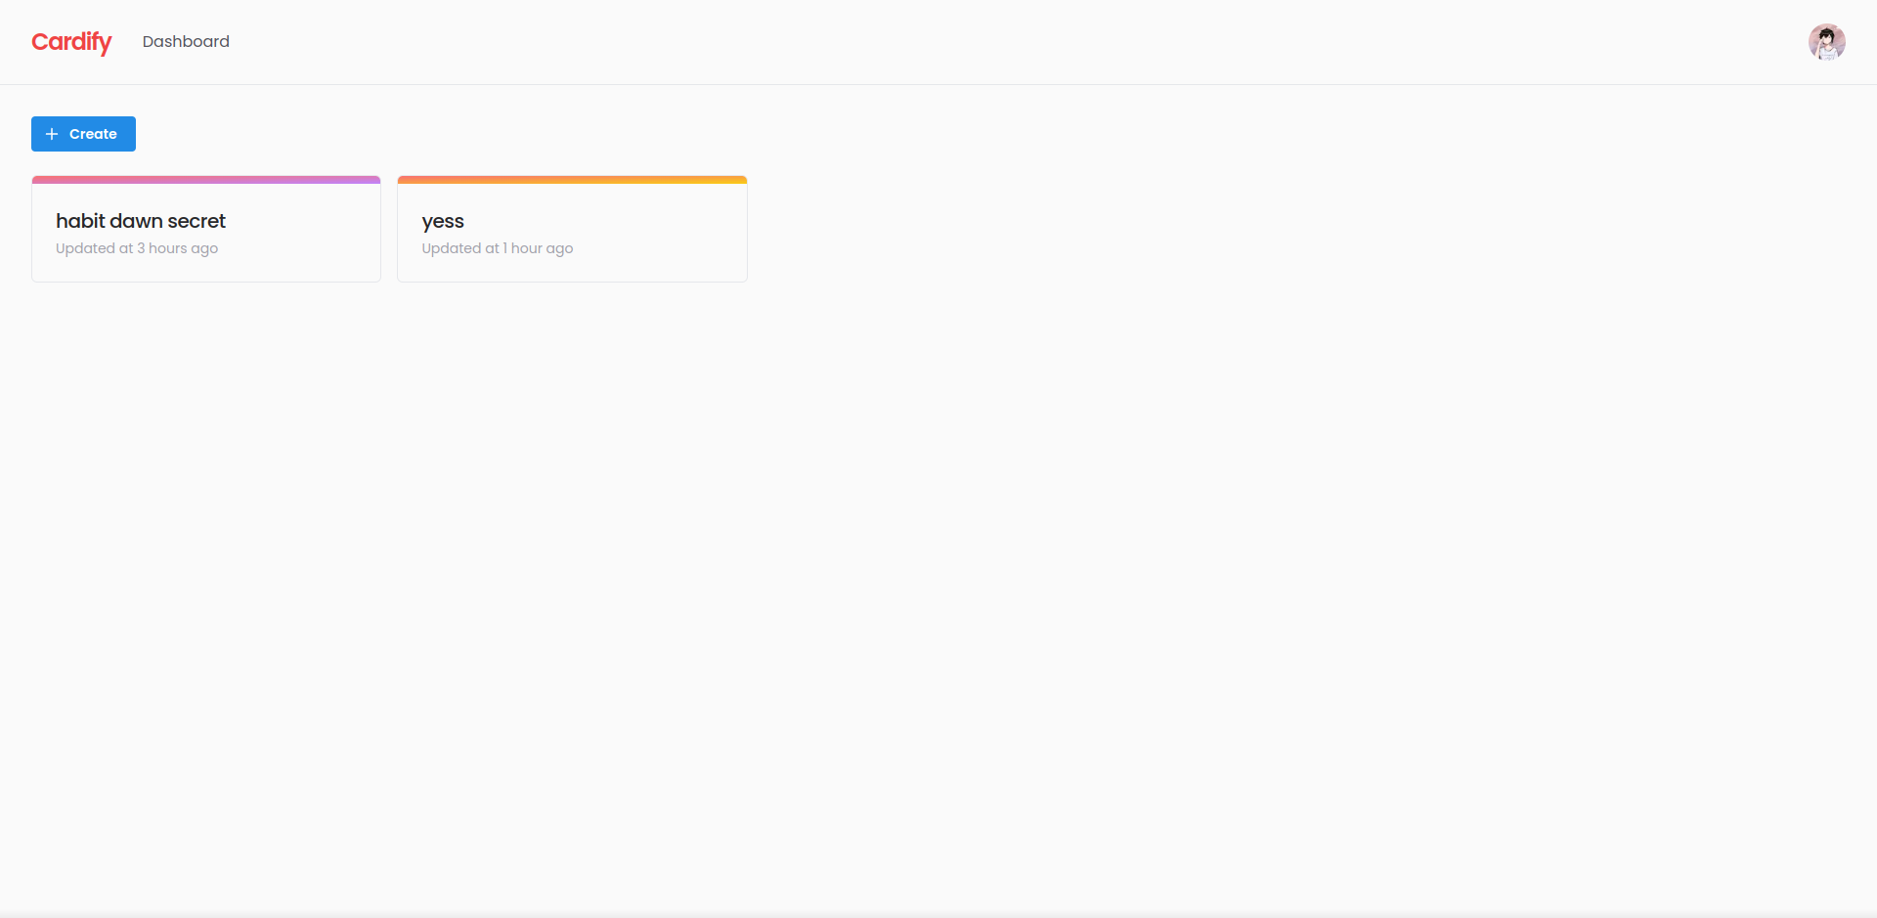
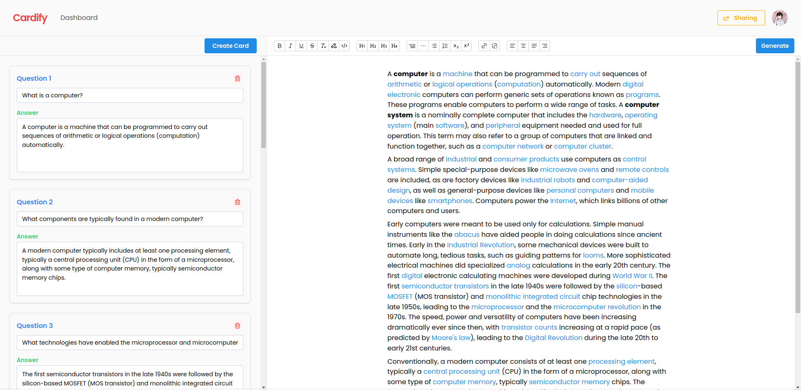
DASHBOARD
EDITOR PAGE
Cardify

Slide 8
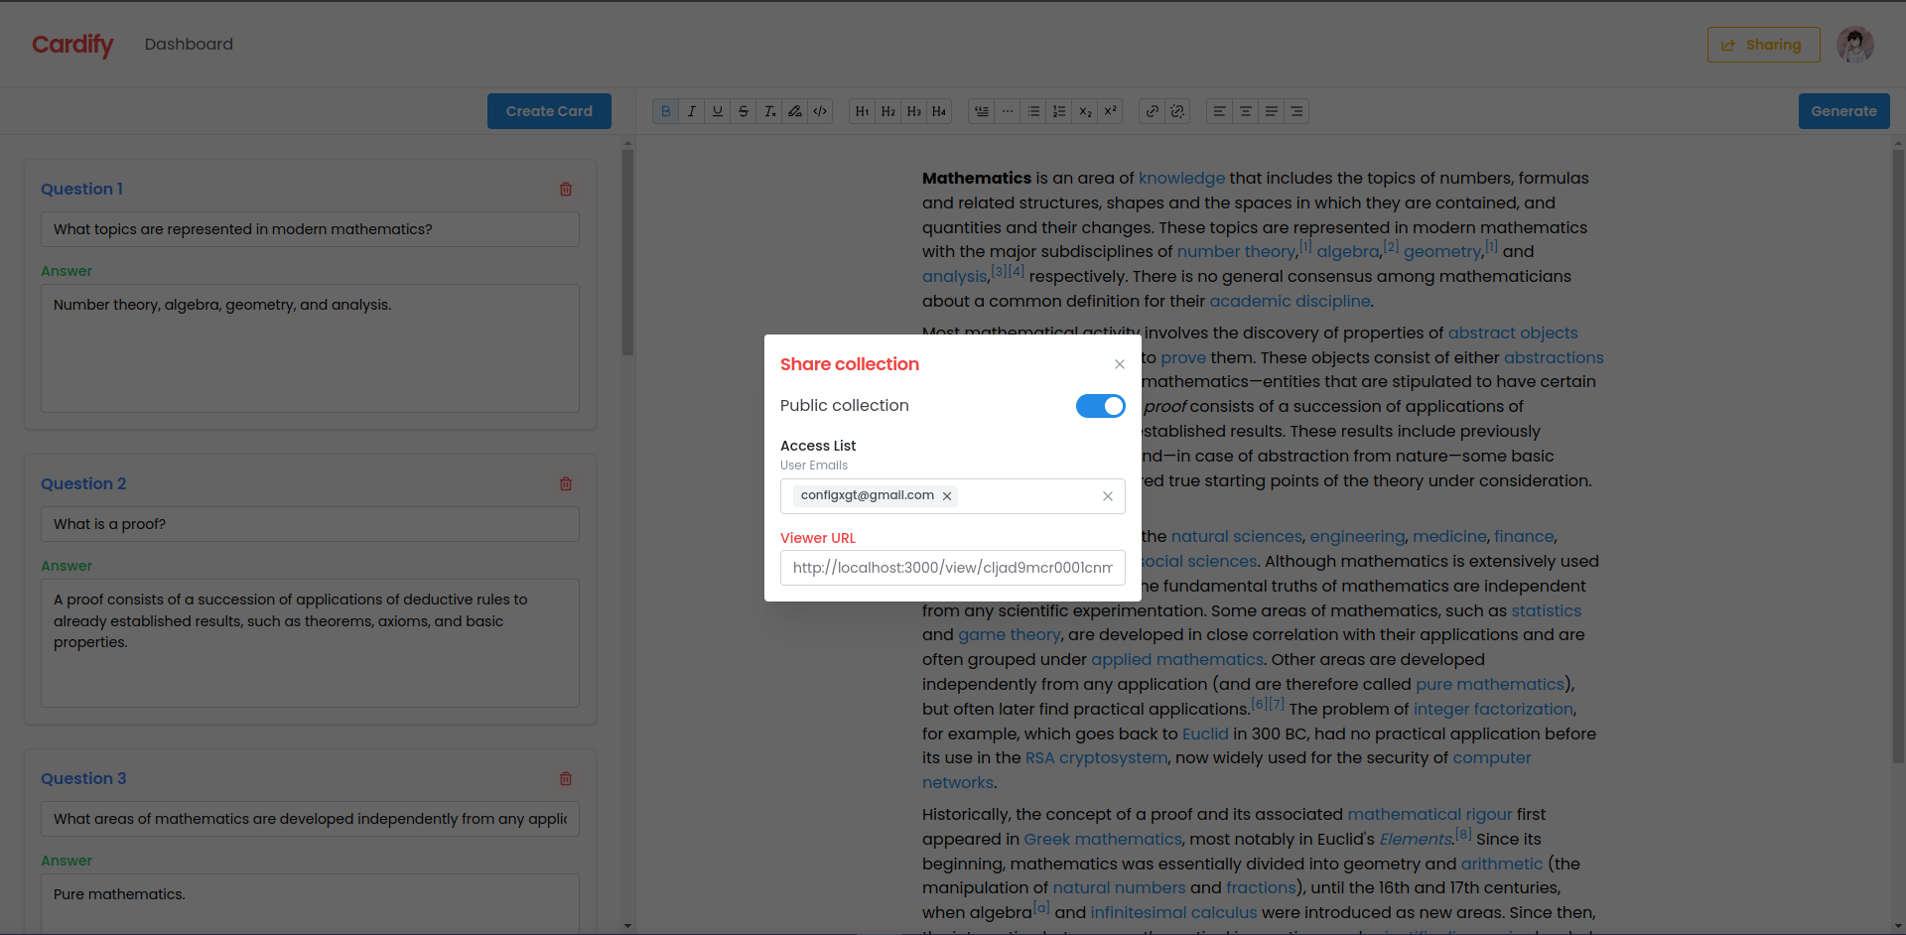
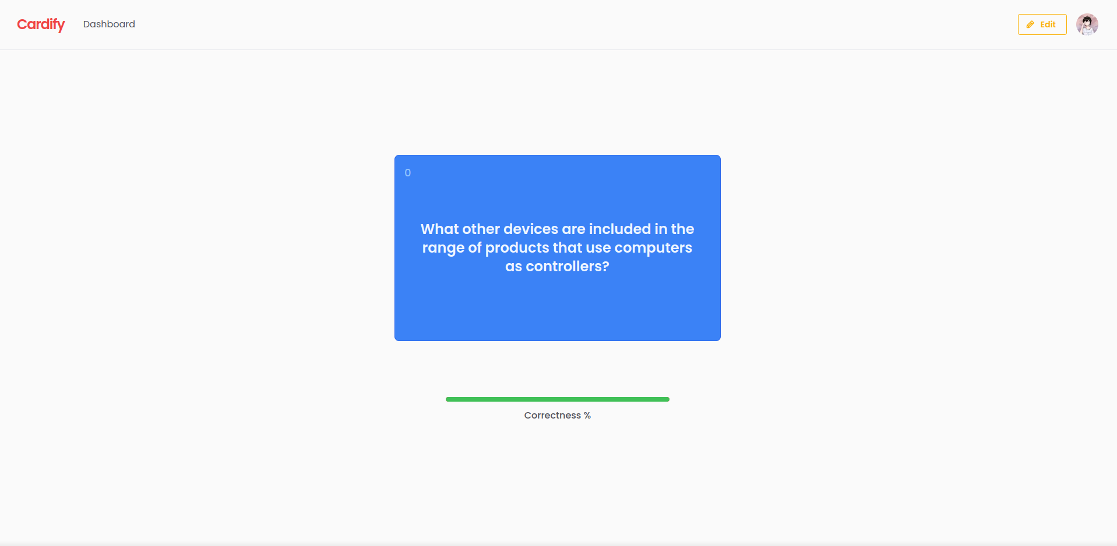
SHARING
VIEWER
CLOSED STATE
Cardify

Slide 9
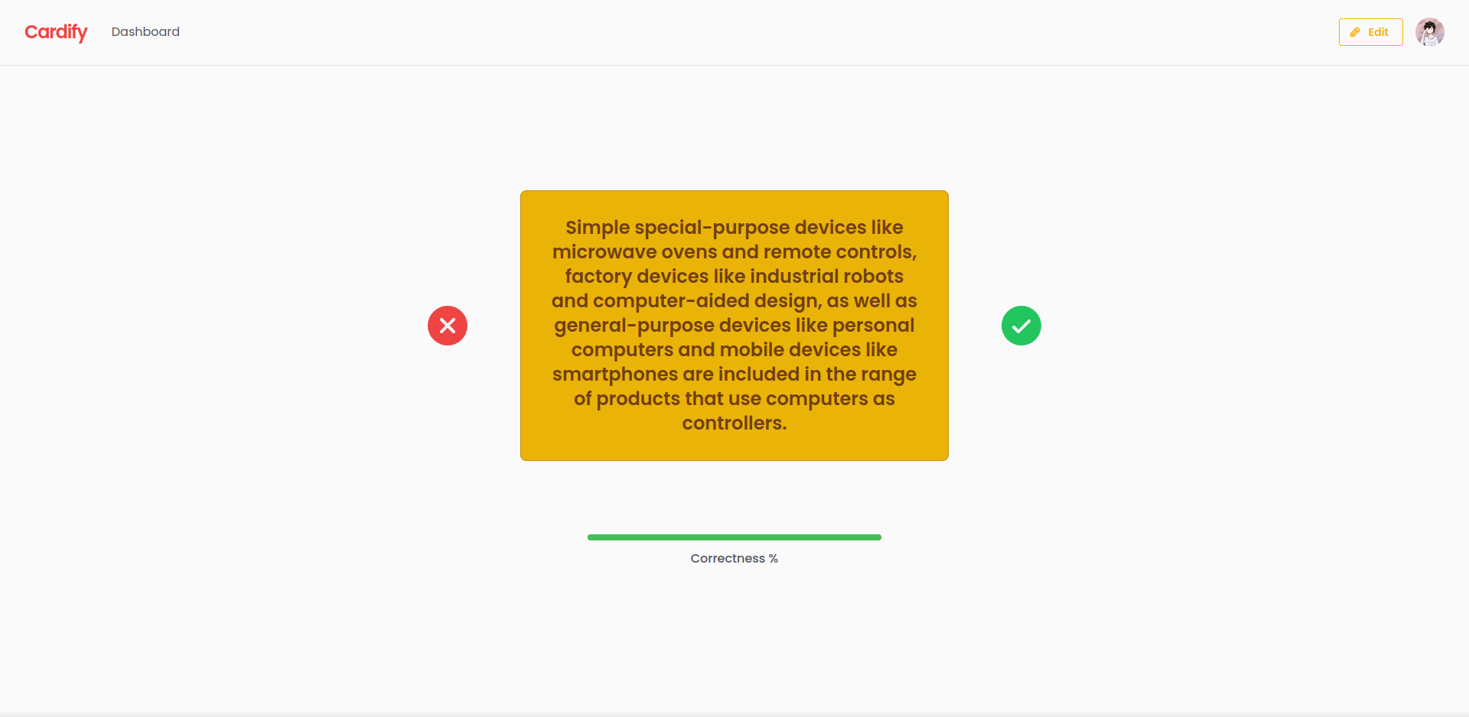
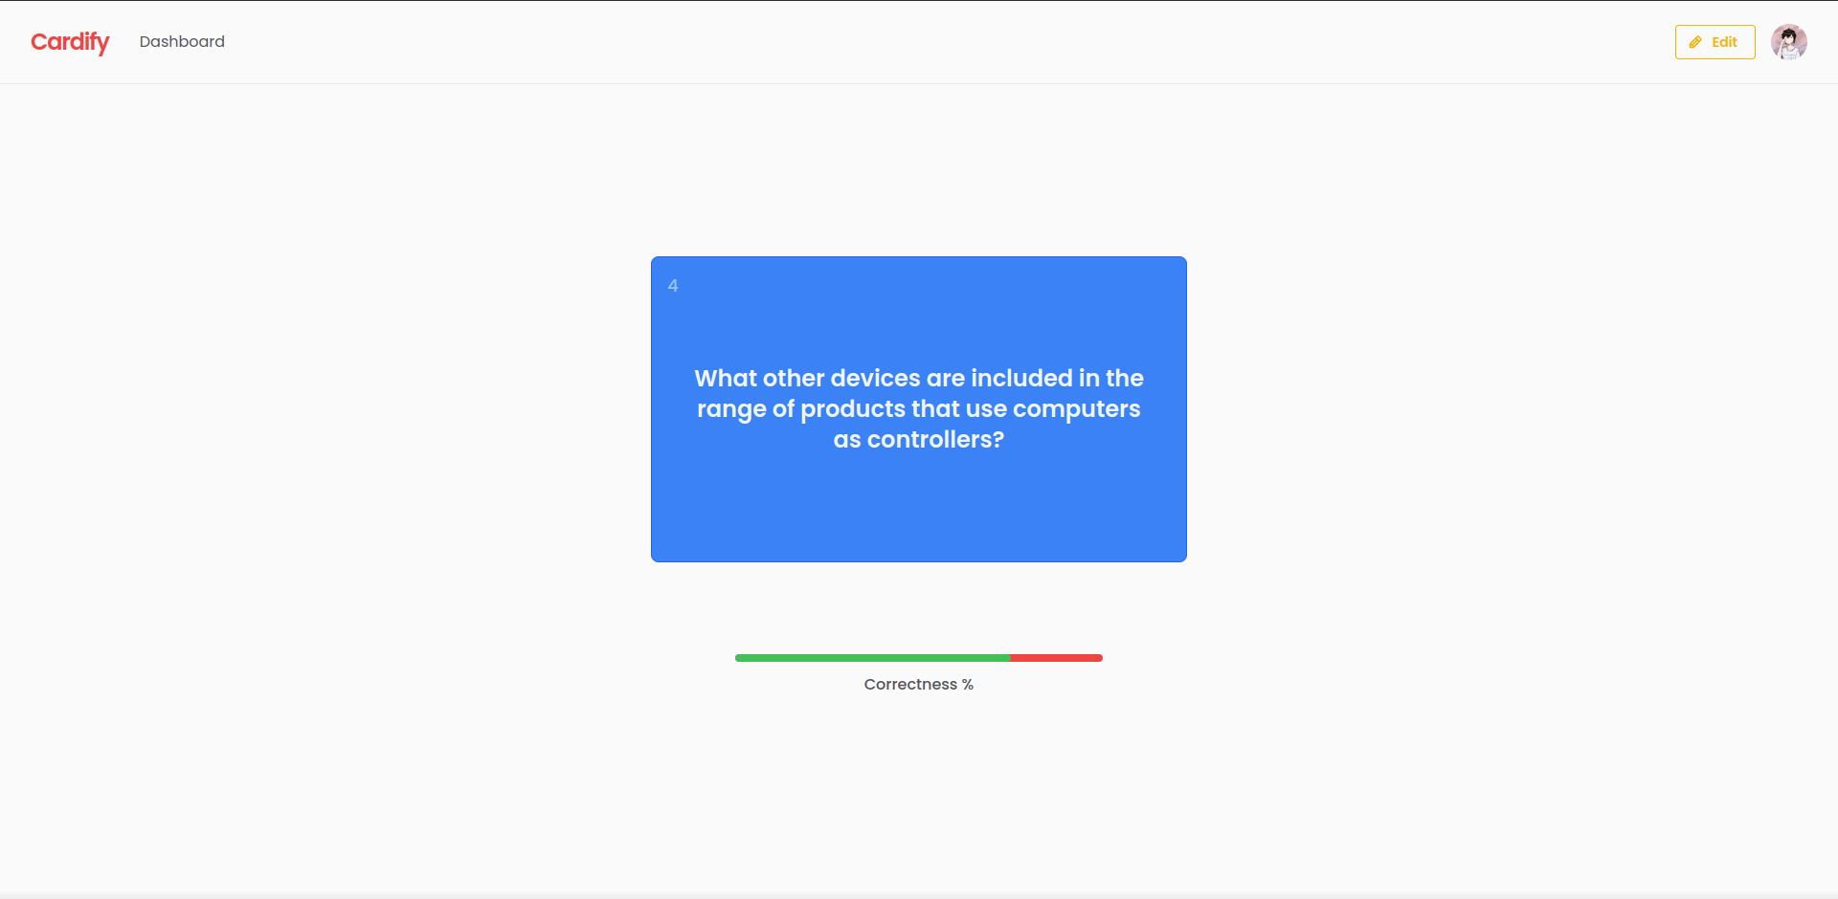
VIEWER
FLIPPED STATE
VIEWER
ANSWERED
Cardify
Read more

Slide 10
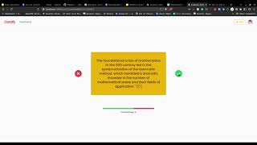
VIDEO PREVIEW
Cardify

Slide 11
THANK YOU
CREDITS
Cardify
for reading & listening.
SlidesGo
SEMESTA Organizer
Everyone that supported me

